Slide 1

CNSCC.203 Computer Networks Application Layer II: DNS and Email
Muhammad Azhar Iqbal
azhar.iqbal@lancaster.ac.uk
Credit goes to Dr. Matt Broadbent, Dr. Vasileios Giotsas, and Dr. Wenjuan Yu at SCC for designing module SCC.203.

Slide 2


Application layer: overview
Principles of network applications
Socket programming with UDP and TCP
Application architectures
Web and HTTP
The Domain Name System DNS
E-mail, SMTP, POP3, IMAP
Chapter 2.3, 2.4

Slide 3
Naming as Basic Principle

Slide 4
Naming & Addressing
Names & Addresses
To call someone, you need to ask for his/her phone number
You cannot just dial “L I B A I”
To mail someone, you need to get their address
How does naming and addressing work in the Internet?
If you need to reach Google, you need their IP
Does anyone know Google’s IP?
Problem:
People can’t remember IP addresses
Need human readable names that map to IP addressess

Slide 5
Internet Names & Addresses
IP Addresses, e.g. 148.88.2.80 (more details discussed in later lecture)
4 bytes (IPv4), have a rigid hierarchical structure, each period separates one of the bytes expressed in decimal notation from 0 to 255
Computer usable labels for machines
Conform to structure of the network
Hostnames, e.g. www.lancaster.ac.uk
Human usable labels for machines
Conform to organizational structure
How do you map from one to the other?
Domain Name System (DNS)
Analogy to DNS: Phone book for the Internet by translating human-friendly computer hostnames into IP addresses

Slide 6
History
Before DNS, all mappings were in hosts.txt
/etc/hosts on Linux
C:\Windows\System32\drivers\etc\hosts on Windows
Process
Maintained manually, centralized
Changes were submitted to Stanford Research Institute (SRI) via email
Machines periodically retrieve new copies of hosts.txt via a FTP server
Any name was allowed
matt_server_at_comp_lancs_lol_kthxbye

Slide 7
The Need for Something Better
System administrators had to update hosts file on every machine to include every host their users might access
Any machine not in hosts file could only be accessed using IP address
If administrators did not update their records on a regular basis, hosts.txt would grow out of date which led to name collisions. For example, ‘www.justexample.com’ produces an answer of both 148.88.2.10 and 148.88.2.141.

Slide 8
Hosts Files Today
You can still find your hosts file in your PC or laptop
/etc/hosts on Linux
C:\Windows\System32\drivers\etc\hosts on Windows
You will most likely not find any entries if you open your hosts file
Not used much – not suited to Internet scale
No trigger for updates – when IP addresses are changed
Can be used to block malicious websites
But it is also a popular target for malware which infiltrates the system and can change the file to lead users being directed to dangerous sites

Slide 9
From hosts.txt to DNS
hosts.txt
Not scalable
need for scalable system
Stanford Research Institute (SRI) cannot handle load
Hard to enforce uniqueness of names
need for unique naming system
e.g., UCL= University College London= Université Catholique de Louvain
Many machines had inaccurate copies of hosts.txt
need for real-time system
hosts.txt was updated periodically
Hence, DNS was born
Paul Mockapetris released the first version in 1984
RFCs 882 and 883, superseded by 1034 and 1035

Slide 10
DNS Service Structure

Slide 11
DNS: Domain Name System
people: many identifiers:
name, passport #, ID number
Internet hosts, routers:
IP address (32 bit) - used for addressing datagrams
“name”, e.g., www.yahoo.com- used by humans
Q: how to map between IP address and name, and vice versa ?
Domain Name System:
distributed database implemented in hierarchy of many name servers
application-layer protocol: hosts, name servers communicate to resolve names (address/name translation)
note: core Internet function, implemented as application-layer protocol
Runs over UDP and uses port 53
complexity at network’s “edge”
Notes:
Like HTTP, FTP, and SMTP, the DNS protocol is an application-layer protocol since it (1) runs
between communicating end systems using the client-server paradigm and (2) relies on an
underlying end-to-end transport protocol to transfer DNS messages between communicating
end systems.

Slide 12
DNS: Domain Name System
DNS is commonly employed by other application-layer protocols, e.g., HTTP and SMTP, to translate user-supplied hostnames to IP addresses
Example: when a browser (HTTP client), running on some user’s host, requests the URL www.lancaster.ac.uk, what will happen?
The same user machine runs the client side of DNS application
The browser extracts the hostname www.lancaster.ac.uk from the the URL and passes the hostname to the client side of the DNS application
The DNS client sends a query containing the hostname to a DNS server
The DNS client eventually receives a reply, including the IP address for the hostname
Once the browser receives the IP address from DNS, it can initiate a TCP connection to the HTTP server process located at port 80 at that IP address
DNS provides a core Internet function, namely translating hostnames to their underlying IP addresses, for user applications and other software in the Internet.

Slide 13
DNS: a distributed, hierarchical database
Root DNS Servers
Root
…
…
.com DNS servers
.org DNS servers
.edu DNS servers
Top Level Domain (TLD)
…
…
…
…
yahoo.com
DNS servers
amazon.com
DNS servers
pbs.org
DNS servers
nyu.edu
DNS servers
umass.edu
DNS servers
Authoritative
Client wants IP address for www.amazon.com; 1st approximation:
client queries one of the root servers to find .com DNS servers
client queries one of the .com DNS servers to get amazon.com DNS servers
client queries one of the authoritative DNS servers for amazon.com to get IP address for www.amazon.com

Slide 14
DNS: structure
Q: Why not centralize DNS?
single point of failure
traffic volume
distant centralized database
maintenance
A: a centralized database in a single DNS server simply doesn‘t scale!

Slide 15
Internet Domain Names
.com
.edu
.gov
.mil
.net
.org
.de
.fr
.uk
Top Level Domain
country code top-level domains
generic top-level domains
.dec
.ibm
.ac
.co
Second Level Domain
Hierarchical names: e.g., www.lancaster.ac.uk
Unnamed root above the top level domain names
Wide but shallow tree structure with thousands of domains
No limit on the number of subdomains or number of levels, e.g., comp.secondlevel.subdivision.division.company.com
.lancs
.york
.comp
dns
mail
mail
dns

Slide 16
Subdomains
In the DNS hierarchy, a subdomain is a domain that is a part of another (main) domain. (source: Wikipedia)
For example, scc.lancs.ac.uk is a subdomain of
lancs.ac.uk
which is sub-domain of
ac.uk
which is sub-domain of
uk

Slide 17
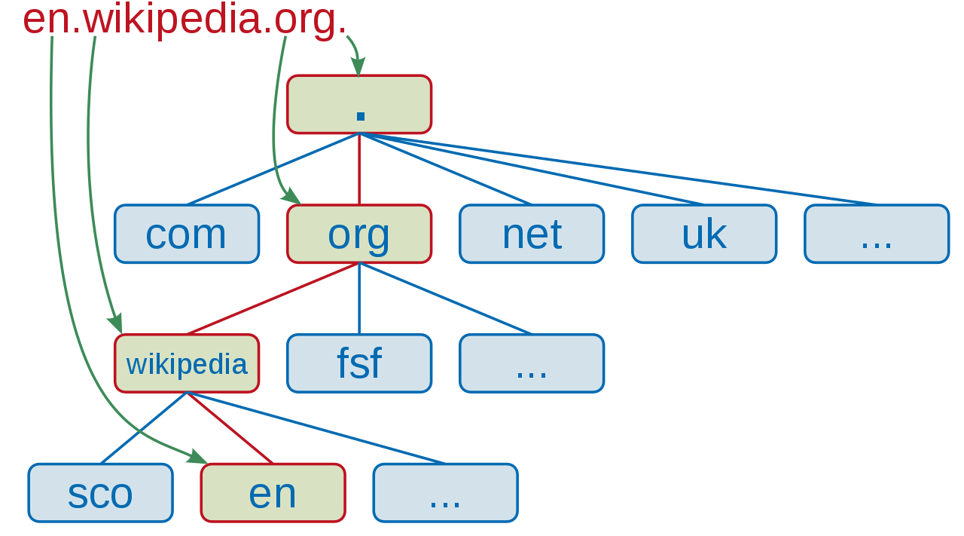
Fully Qualified Domain Names (FQDN)
A fully qualified domain name (FQDN), sometimes also referred to as an absolute domain name, is a domain name that specifies its exact location in the tree hierarchy of the DNS.
It usually consists of a host name and at least one higher-level domain (label) separated by the symbol "." and always ends in the top-level domain. (source: Wikipedia)
FQDNs traditionally end with a dot
For example,
mail.google.com.
en.wikipedia.org.
Structure of the above two examples:
[local hostname].[second level domain].[tld].[root label (empty)]
From right to left, root label (empty), top level domain (.org), second level domain (.wikipedia) and local hostname (en)

